Slide 1
SALES DATA ANALYSIS
ANUPRIYA
12.12.2024
DATA ANALYSTICS & DATA SCINCE
OCT 2024 (REGULAR)

Slide 2
OVER VIEW
A project overview outlines the important details of your project, such as its goals and potential risks.
Knowing more about project overviews and how to create one can help you stay organized and work more efficiently
GOAL
measurable action items that support the goal's success.
They are essential because they promote improvement and help manage progress.
Create a dynamic dashboard with key metrics.

Slide 3
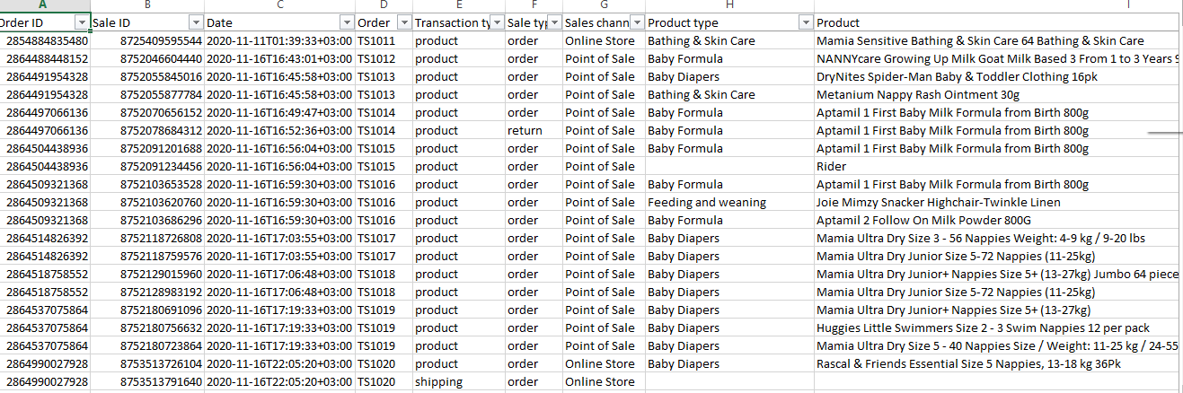
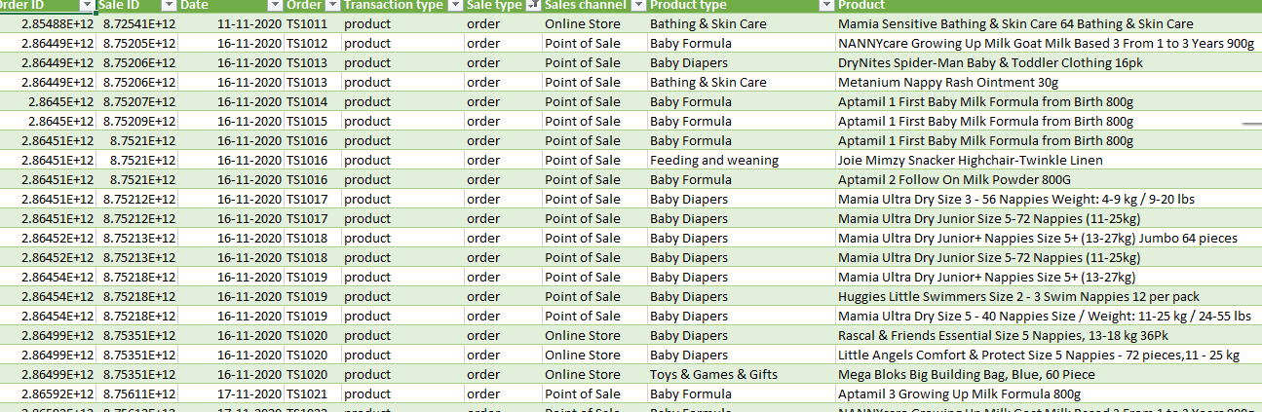
Data Description
Data set overview.
In the data we have sale analysis.
We are here to analyze the online and offline sales analysis.
Data cleaning
Create a backup copy of original data.
Ensure your data's in a tabular format with similar data in each column.
Extract the data into the power query
And clean the null, blank rows and columns.

Slide 4
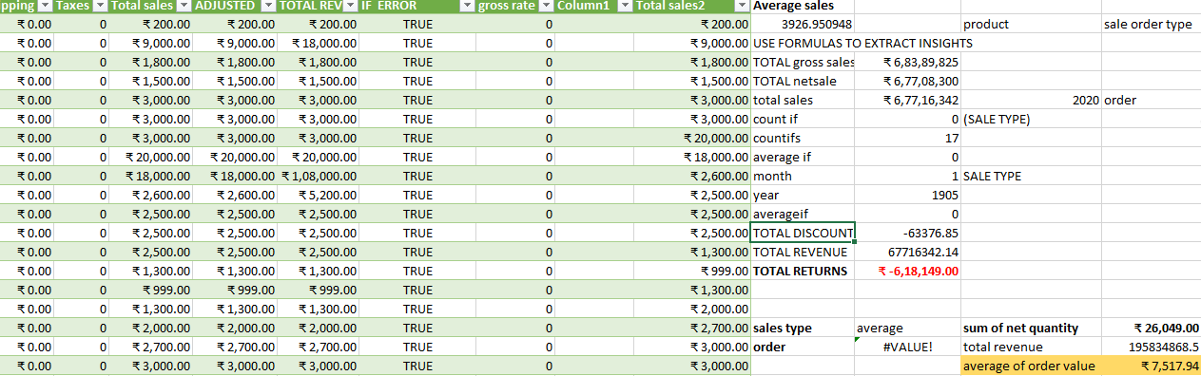
IMPORTANT CALCULATIONS
Total sales(gross net, adjusted)
Average sales per order
Discount rates, return rates
Sales by channel/ product type

Slide 5
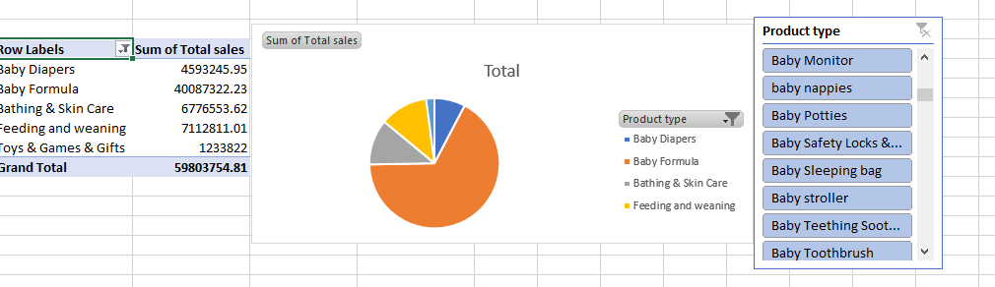
Pivort Tables and Chart
In these pivot chart and table
We have list of product types
Sort the product type into top 5
In the product type pivot I have analyzed the
Total sales of the particular product is baby formula

Slide 6
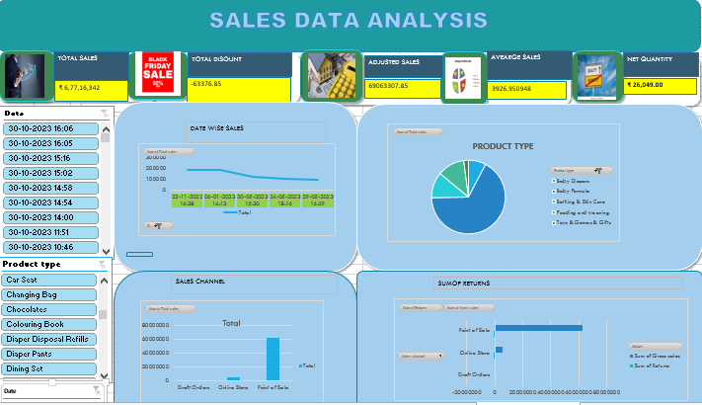
Dash board

Slide 7
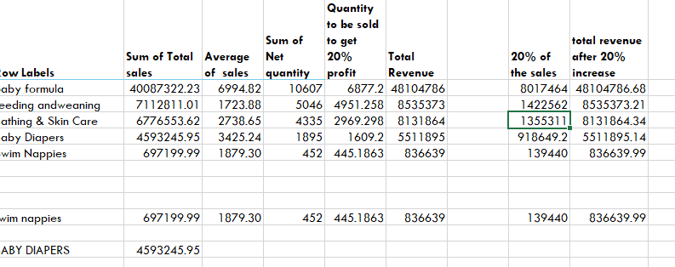
WHAT IS IF ANALYSIS
What-if analysis is done using Goal seek
Target value is 20%

Slide 8
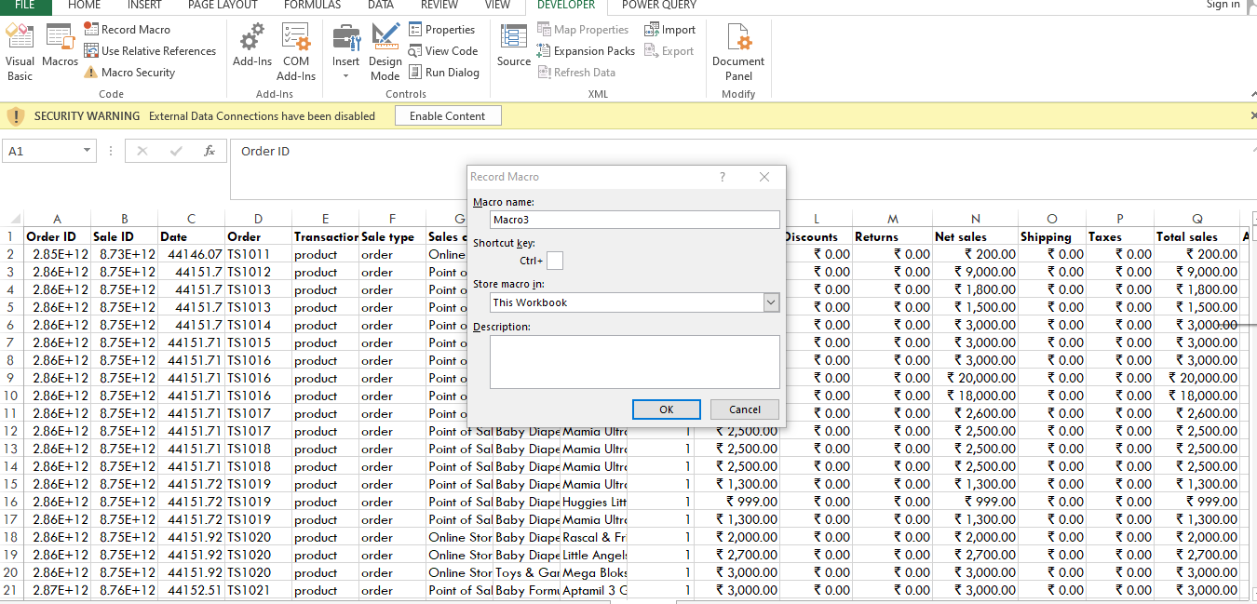
MACROS AND AUTOMATION
In Microsoft Excel, macros are used to automate tasks by recording a series of actions, such as keystrokes and mouse clicks:

Slide 9
Insights
Top selling Products are Baby Formula
Sale is very high in Autumn month( particularly in baby formula)
Toys games& Gifts are very low sale at the time

Slide 10
Conclusion
In the sales data analysis
We have diverse products in that we can change the price or reverse the price rate
In the future we can contrate on the online store to develop our sales giving a discount to the customers or take giving take away
In these sales insights in the sales channels we have high sales in point to sales

Slide 11


